Slide 1

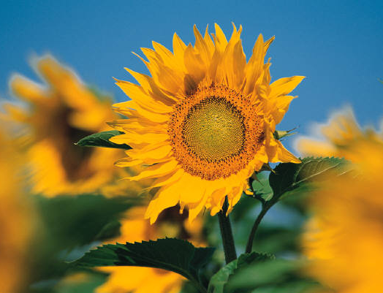
Contemporary Photo Album
Notes:
There are also CELEBRATIONS resources for children produced by GC Children’s Ministries Department.
A musical version of CELEBRATIONS for Kids is also available on DVD from GC Children’s Ministries.

Slide 2
A book based on the GC Health Ministries program CELEBRATIONS.
For primary age children.
Includes activities within the pages of the book.

Slide 3
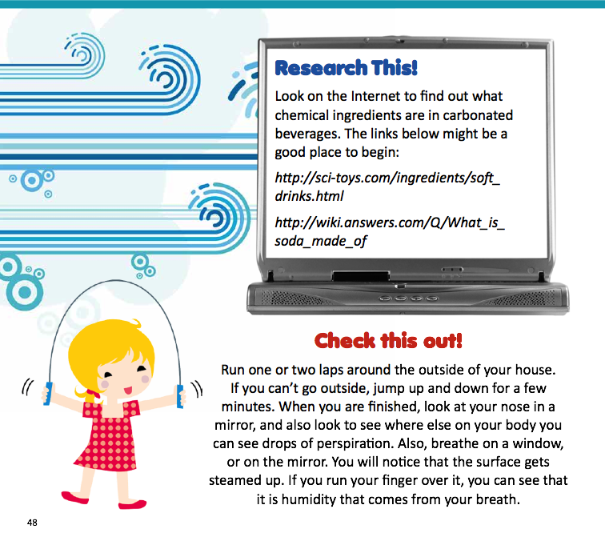
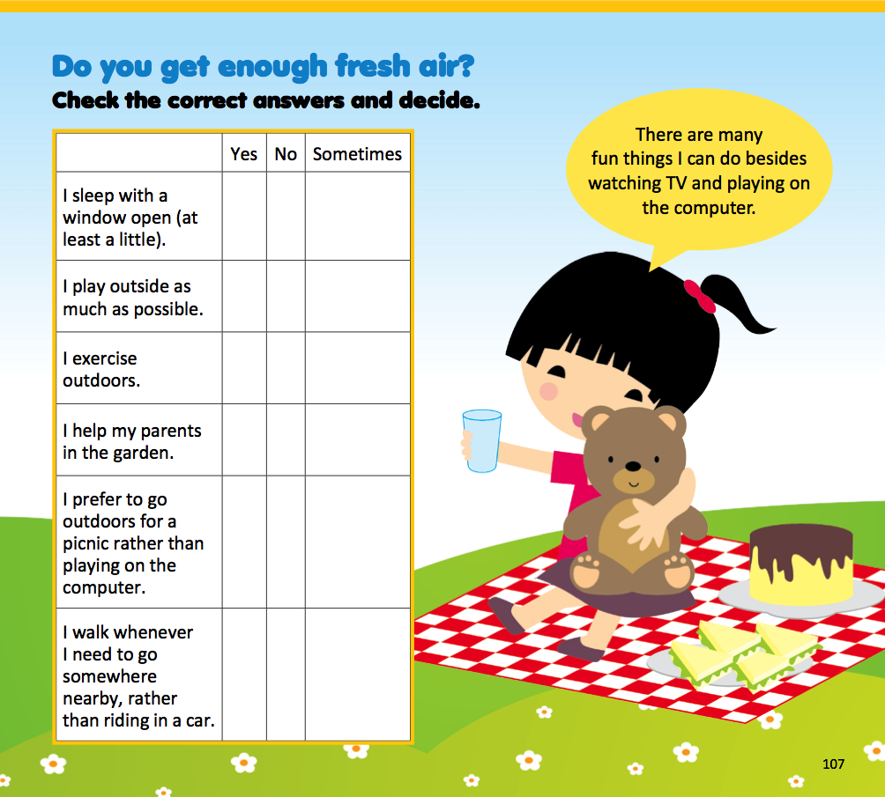
Sample Pages

Slide 4
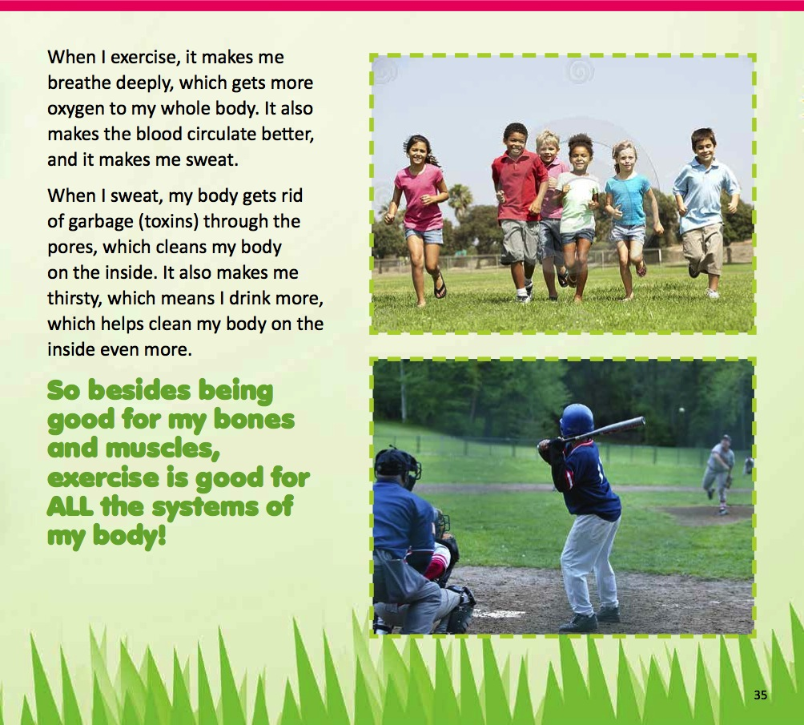

Slide 7
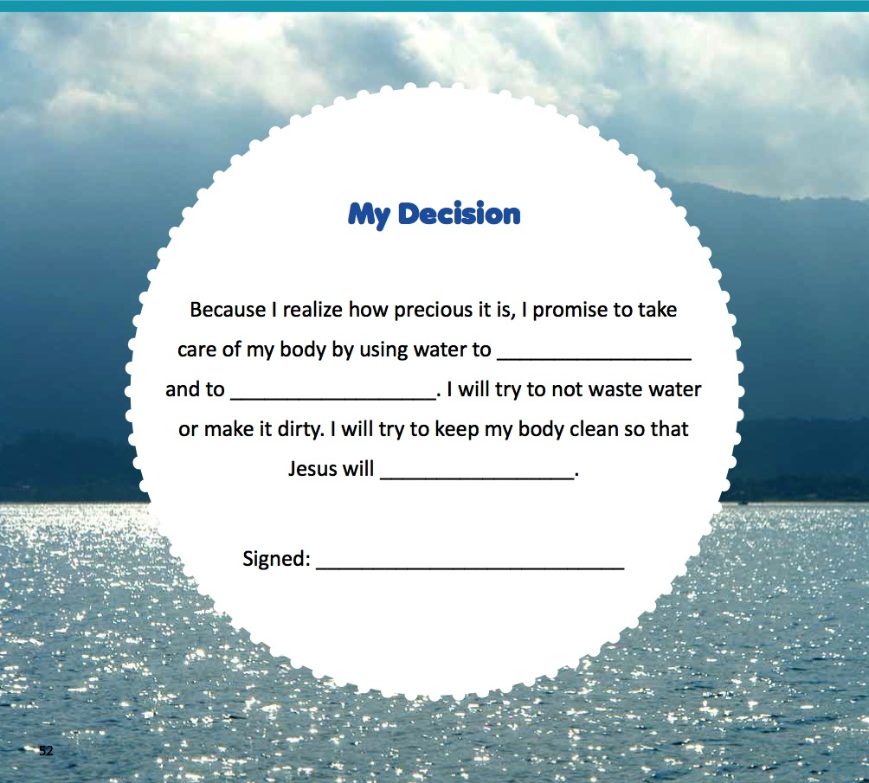
* There’s a decision page for children to make a pledge

Slide 8
There is a songbook and a CD of songs for each letter of the title: CELEBRATIONS.
There is a booklet of health skits that children can have fun learning about health. They will be published by Review & Herald.
There is a CELEBRATIONS drama and DVD which was launched in the summer of 2014 at the Geneva Health Conference.

